Slide 1


Slide 2
PREVIEW
Analytical Approach
Individual assessment charts
Free Learning material (incl access to additional resources for overall devp in Academic Perspectives)
Formulae Charts & Work Sheets
Periodical Assessment Tests
Emphasis Areas & Scope refinement
Mock Tests
Revision Sessions

Slide 3
TUTORING PATTERNS
Chapter-wise Tests
Calibration Tests
Mock Tests
Assessment Tests
Pre-Final / Final Tests
Formulae Sheets
Revision Notes

Slide 4
66 days
30 days
23 days
45 days
43 days
10 days
7 days
8 days
1 day
Level-1
Apr 1 - Jul 1
Schedule : 2022-23
Term Break -A
May 15 - Jun 15
2022
Jul 15 - Sep 15
Level-2
Term Break-B
Oct 2 - Oct 11
Level-3
Oct 12 - Dec 10
Term Break-C
Dec 24 - Jan 4
Level-4
Jan 5 - Feb 15
Revision Sessions
Feb 16 - Mar 1
Calibration Test
Mar 2 - Mar 5
Commencement of classes
Apr 1
Feb
Apr
Jun
Aug
Oct
Dec
Feb
2023
Today
Registrations Window
Feb 15
Admissions
Orientation Session
Mar 27
Mar 30
Zero Test for Foundation
Jul 1
Assessment : Level-1
Assesments
Sep 16
Assessment : Level-2
Dec 15
Assessment : Level-3
Feb 16
Assessment : Level-4
Mock Tests
Pre-Finals
Feb 28
Finals
Mar 3

Slide 5
SUBJECT OVERVIEW

Slide 6
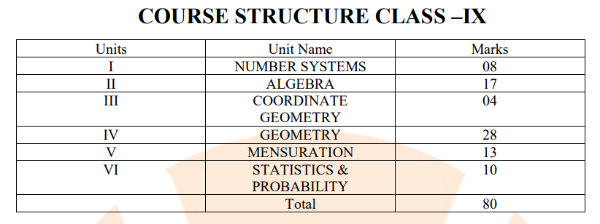
SYLLABUS
Class - VIII
Ser | Chapters
I | Rational Numbers
II | Linear Equations in one variable
III | Understanding quadrilaterals
IV | Practical Geometry
V | Data Handling
VI | Squares,Cubes, Cube roots
VII | Algebraic expression & Identities
VIII | Mensuration
IX | Direct & Inverse Proportions
X | Factorisation
Class - VII
Ser | Chapters
I | Fractions & Decimals
II | Simple Equations
III | Data Handling
IV | Triangle & Properties
V | Congruence of Triangles
VI | Comparing quantities
VII | Practical Geometry
VIII | Perimeter & Area
IX | Algebraic Expressions
X | Exponents & Powers

Slide 7
SYLLABUS
Class 6 – Mathematics - Syllabus Mathematics
Chapter 1: Knowing our Numbers • Comparing Numbers
Chapter 2: Whole Numbers • Whole Numbers • The Number Line • Properties of Whole Numbers • Patterns in Whole Numbers
Chapter 3: Playing with Numbers • Factors and Multiples • Prime and Composite Numbers • Tests for Divisibility of Numbers • Common Factors and Common Multiples • Some More Divisibility Rules • Prime Factorisation • Highest Common Factor • Lowest Common Multiple • Some Problems on HCF and LCM
Chapter 4: Basic Geometrical Ideas • Points • A Line Segment • A Line • Intersecting Lines • Parallel Lines • Ray • Curves • Polygons • Angles • Triangles • Quadrilaterals • Circles
Chapter 5: Understanding Elementary Shapes • Measuring Line Segments • Angles – ‘Right’ and ‘Straight’ • Angles – ‘Acute’, ‘Obtuse’ and ‘Reflex’ • Measuring Angles • Perpendicular Lines • Classification of Triangles • Quadrilaterals • Polygons • Three Dimensional Shapes
Chapter 6: Integers • Integers • Addition of Integers • Subtraction of Integers with the help of a Number Line
Chapter 7: Fractions • A Fraction • Fraction on the Number Line • Proper Fractions • Improper and Mixed Fractions • Equivalent Fractions • Simplest Form of a Fraction • Like Fractions • Comparing Fractions • Addition and Subtraction of Fractions
Chapter 8: Decimals • Tenths • Hundredths • Comparing Decimals • Using Decimals • Addition of Numbers with Decimals • Subtraction of Decimals
Chapter 9: Data Handling • Recording Data • Organisation of Data • Pictograph • Interpretation of a Pictograph • Drawing a Pictograph • A Bar Graph
Chapter 10: Mensuration • Perimeter • Area
Chapter 11: Algebra • Matchstick Patterns • The Idea of a Variable • More Matchstick Patterns • More Examples of Variables • Use of Variables in Common Rules • Expressions with Variables • Using Expressions Practically • What is an Equation? • Solution of an Equation
Chapter 12: Ratio and Proportion • Ratio • Proportion • Unitary Method
Chapter 13: Symmetry

Slide 8
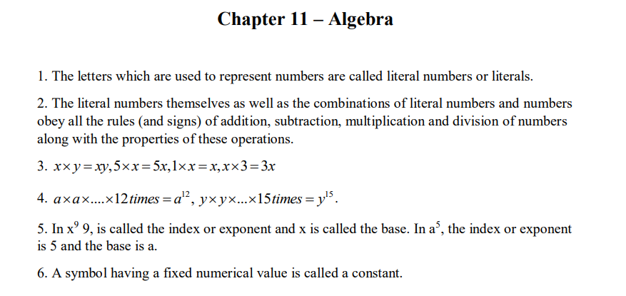
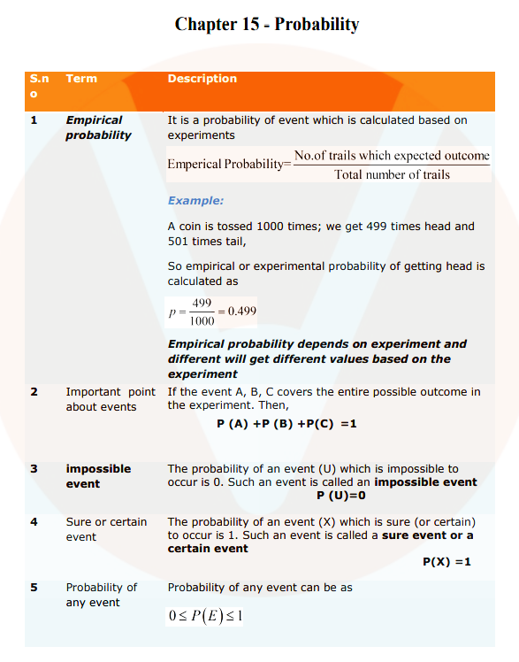
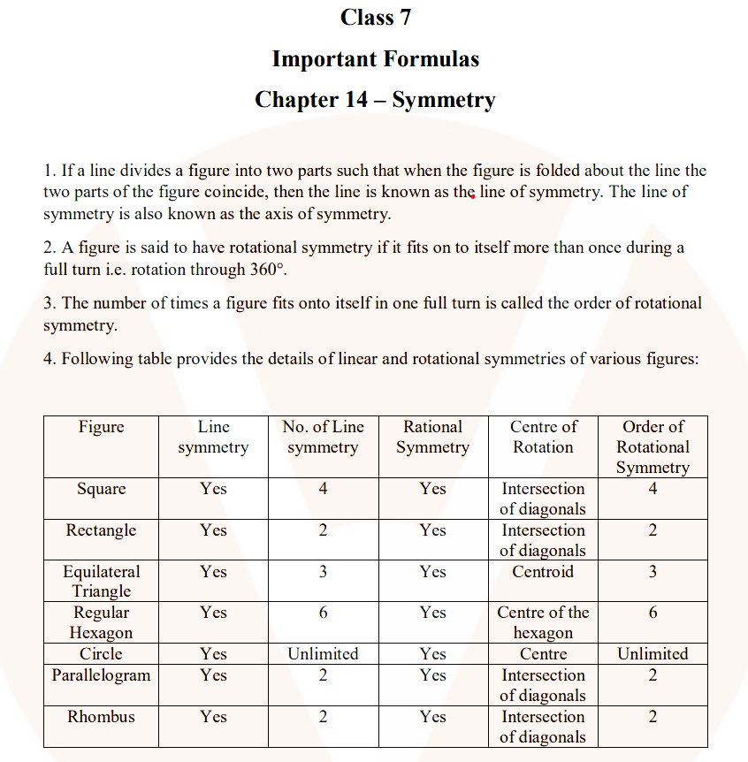
FORMUALE CHARTS

Slide 9
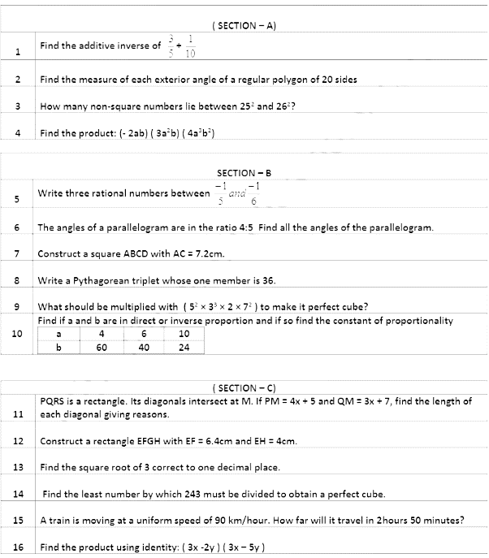
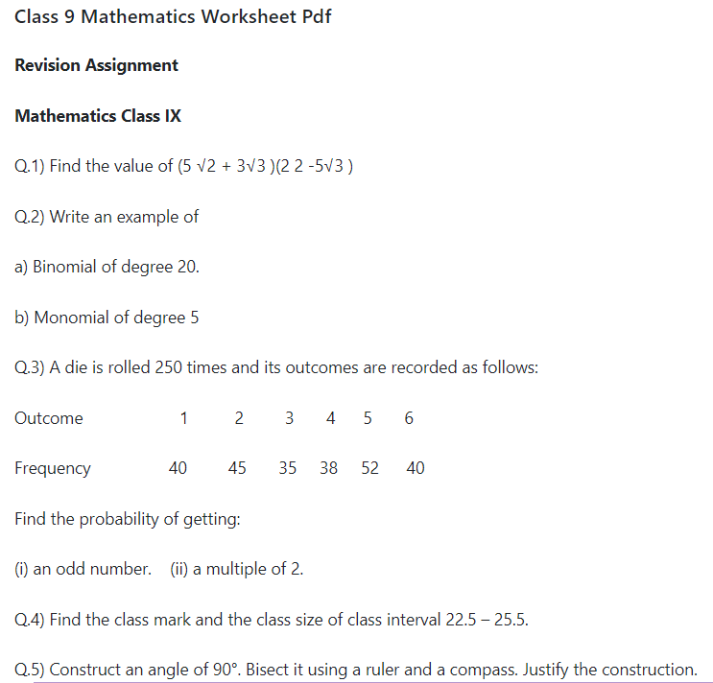
PRACTICE SHEETS

Slide 10
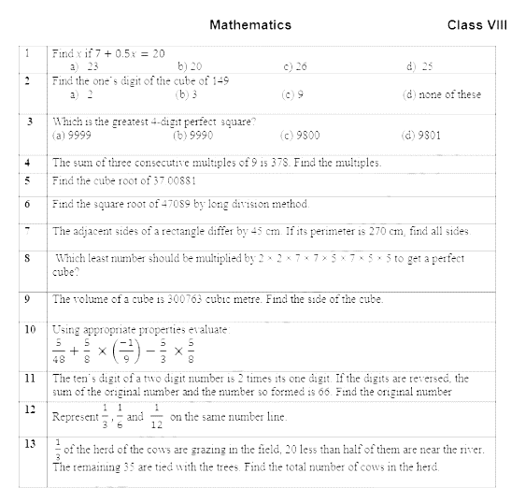
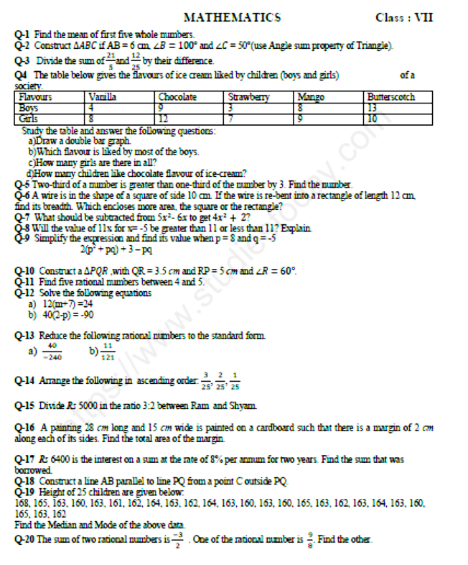
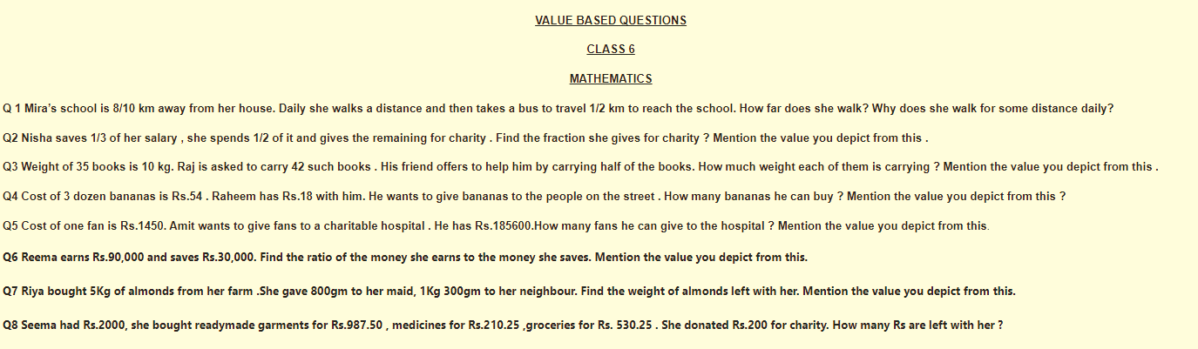
PRACTICE SHEETS

Slide 11
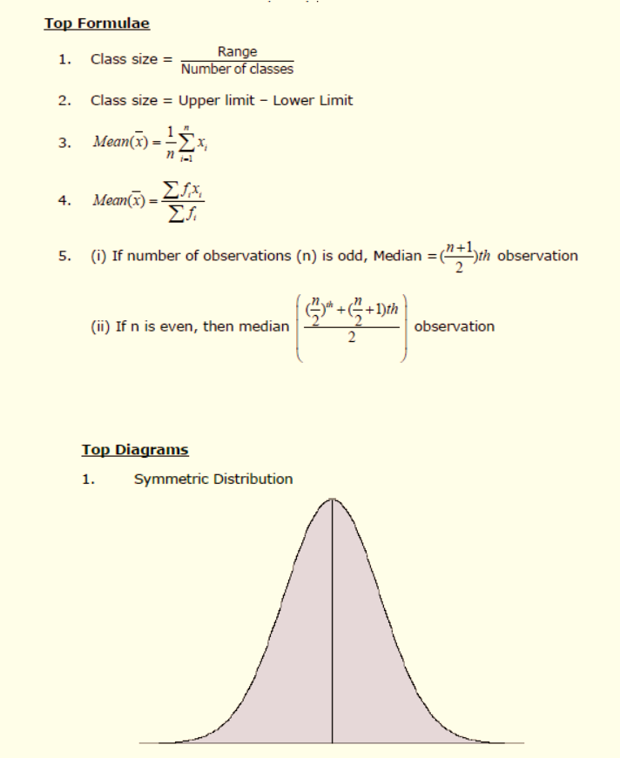
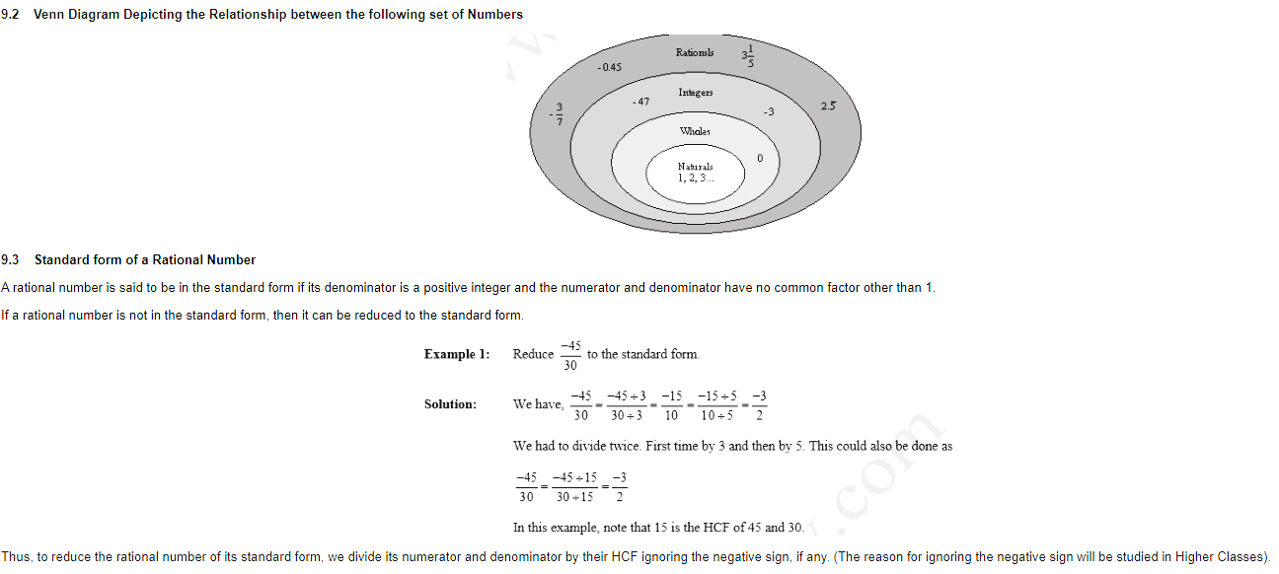
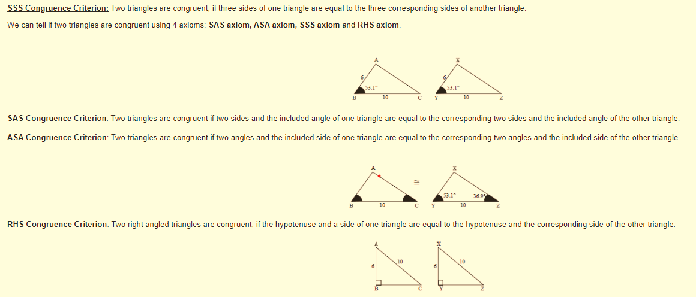
REVISION NOTES

Slide 12
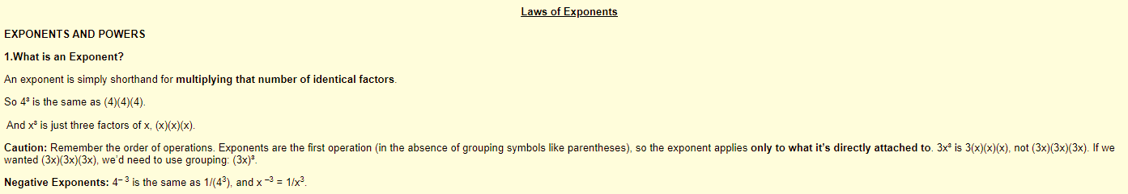
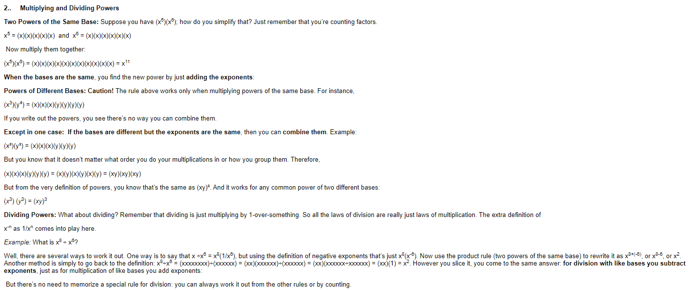
REVISION NOTES

Slide 13
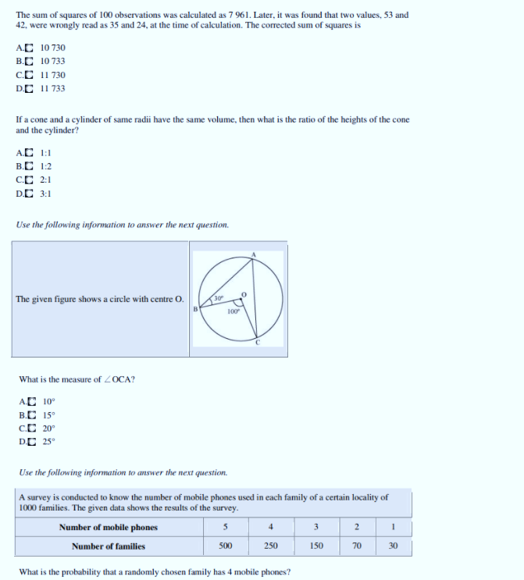
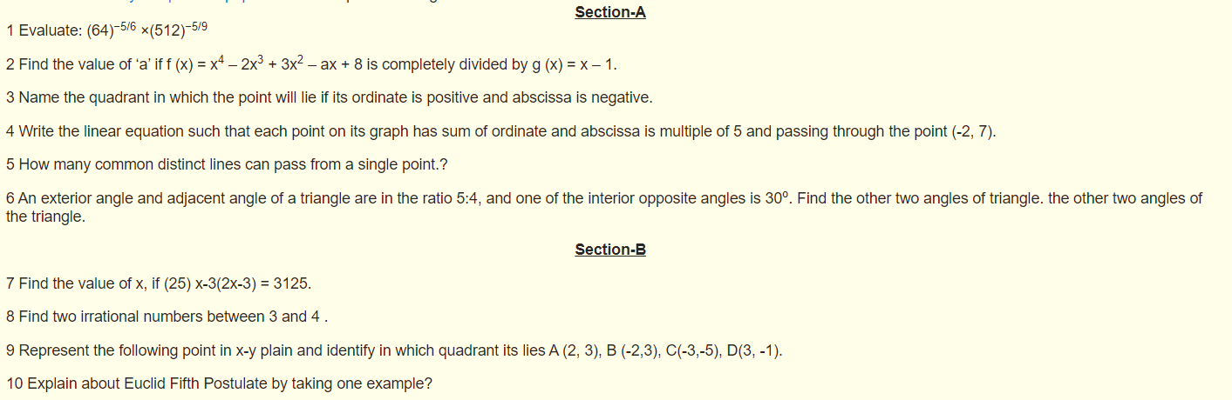
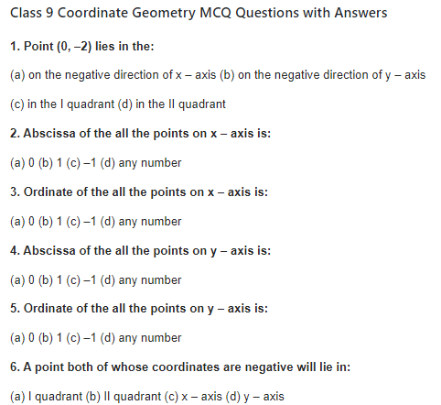
ASSESSMENT TESTS

Slide 14
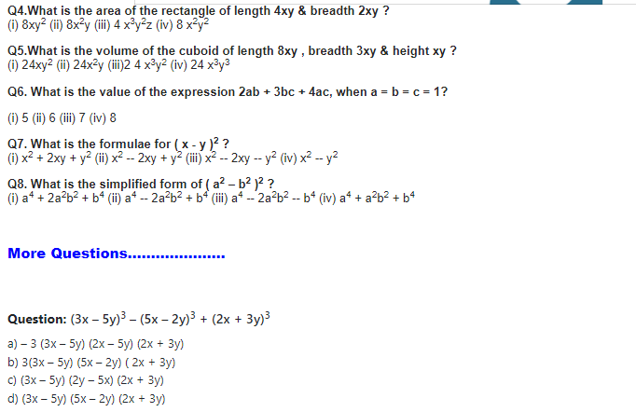
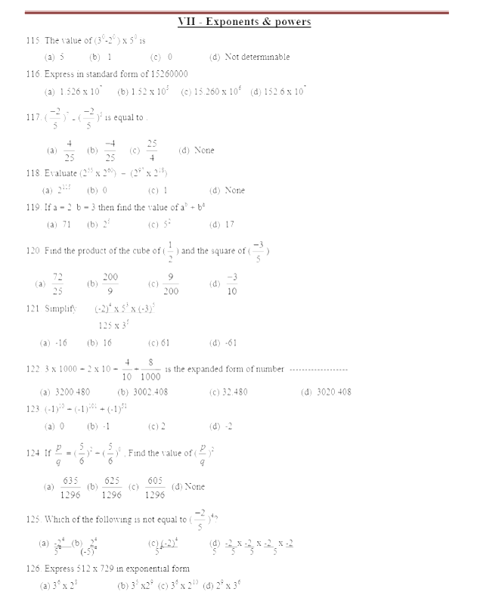
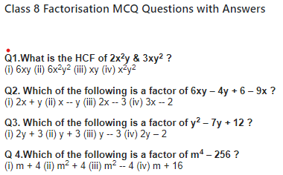
ASSESSMENT TESTS

Slide 15
PERFORMANCE ANALYSIS

Slide 16

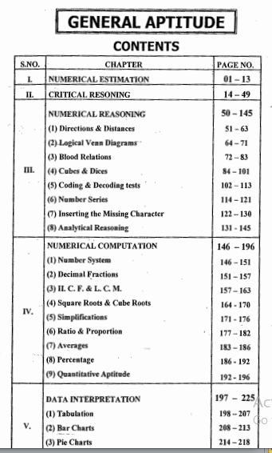
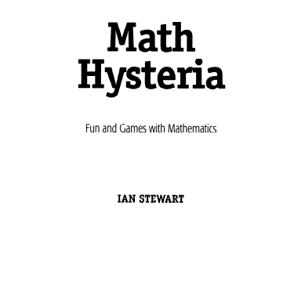
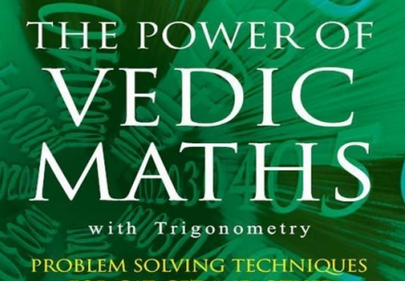
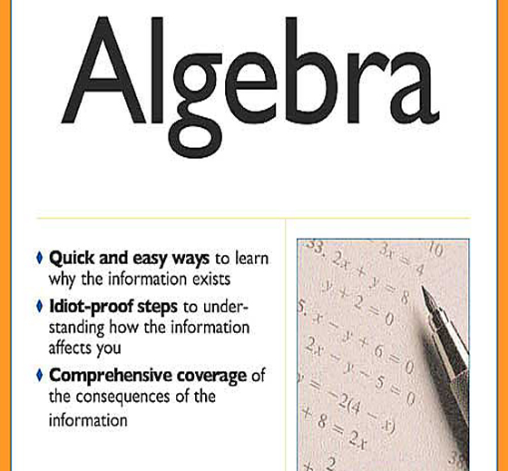
WAY AHEAD

Slide 17




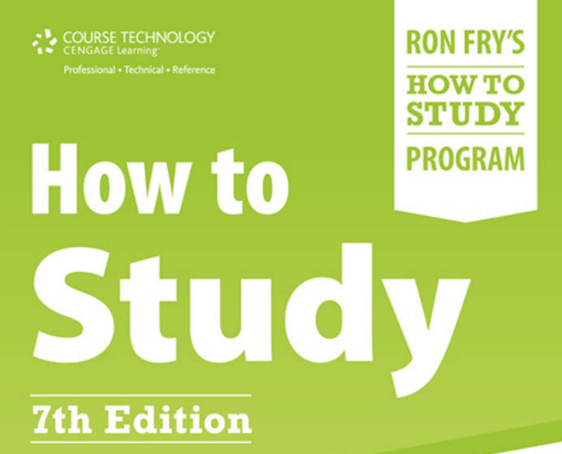
LOOKING BEYOND

Slide 18
COMMUNICATION
EMAIL : 📧 2utorverse@gmail.com
Web Address : https://github.com/2utorverse/Brochure.git
https://github.com/2utorverse/Orientation.git
https://github.com/2utorverse/Mathematics.git
https://github.com/2utorverse/Power-Resources.git
https://github.com/2utorverse/Gen-Academics.git
CONTACT : 9910512343

Slide 19

GOOD WISHES

